Slide 1
Activities and Tools
for Teaching Pronunciation
Marla Yoshida
University of California, Irvine
Division of Continuing Education
yoshidam@uci.edu

Slide 2
Overview
Teaching the pronunciation of sounds
Teaching the musical aspects of pronunciation

Slide 3
How can we help learners reach their pronunciation goals?
Provide information
Provide practice
Provide feedback
It’s a continuous process.

Slide 4

How?
“Repeat after me” is useful,
but it’s not enough for successful
pronunciation learning.
Do more than simply teach rules
and use mechanical drills.
Use a variety of techniques—sound, sight, movement, and meaningful activities.

Slide 5
Pronunciation teaching includes…
Individual sounds (consonants and vowels)
The musical aspects of pronunciation, such as
  Syllables and word stress
  Thought groups and pauses
  Prominence and intonation
  Connected speech

Slide 6
Teaching sounds
When explaining about pronunciation:
  K.I.S.S. = Keep it short and simple!
It’s not enough to just explain how to say a sound. We also need to show—in more than one way.
Learning pronunciation takes time. Students need to practice a lot and create muscle memory.

Slide 7


Modeling pronunciation of sounds
Demonstrations by the teacher
Sagittal section diagrams (“Sammy diagrams”)

Slide 8
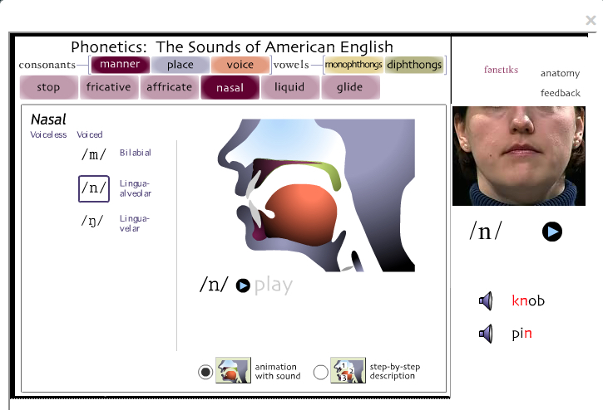
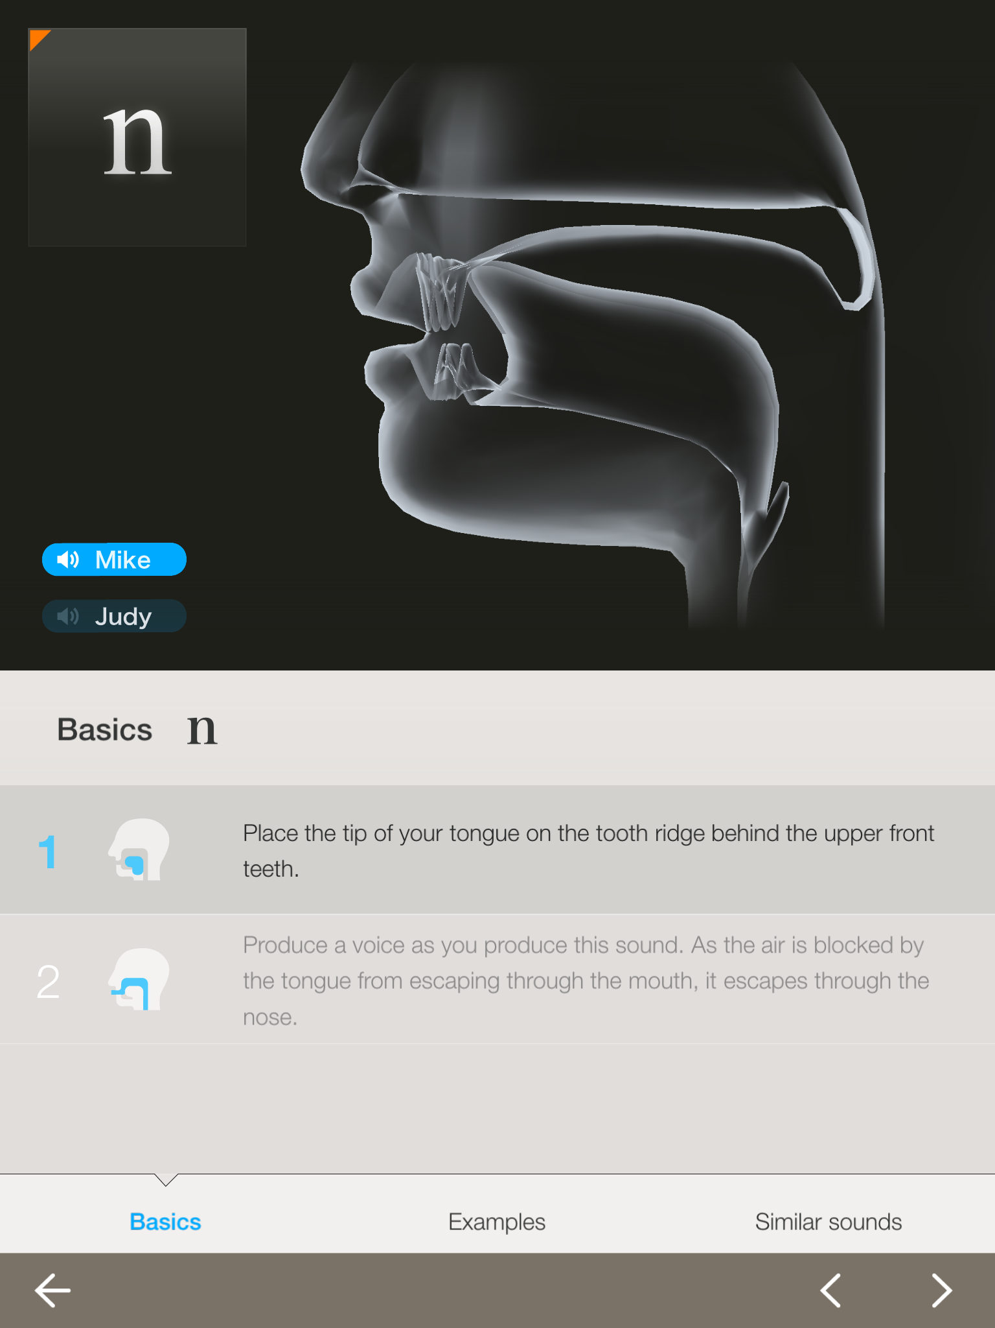
Modeling pronunciation of sounds
Sounds of Speech (Univ. of Iowa)
http://soundsofspeech.uiowa.edu
Websites
and Apps
The Phonetics
http://d3492jnbjg00z1.cloudfront.net/

Slide 9
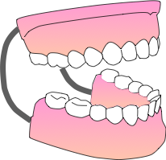
Modeling pronunciation of sounds
A dental model and “tongue puppet” are useful in showing how some sounds are produced.

Slide 10
Activities for practicing sounds
Move from simple to more difficult; don’t rush it!
  Very controlled practice

Slide 11
Activities for practicing sounds
Move from simple to more difficult; don’t rush it!
  Guided practice
  Very controlled practice

Slide 12
Activities for practicing sounds
Move from simple to more difficult; don’t rush it!
  Communicative practice
  Guided practice
  Very controlled practice

Slide 13
Very controlled practice
Words, sentences, minimal pairs, and dialogues
(There are lots of /r/ and /l/ sounds in this one.)
Lisa: I wish I had a driver’s license. I’m so tired of taking the bus or asking my friends for a ride.
Rob: Me too. Every time I want to go to the store I have to ask my roommate to take me.
Lisa: Your roommate has a car? You’re so lucky!

Slide 14
Minimal pairs
What can you do with minimal pairs?
Listen and repeat
Which one am I saying?
  Both sight and sound
  Sound only
  Sight only
Have students practice with each other
Have students write sentences to practice using both words: “I think the sink is broken.”
think
sink

Slide 15
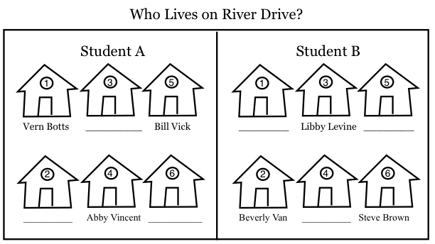
Guided practice: A simple info gap

Slide 16
Communicative practice
  To be practical, learners need to be able to use pronunciation in real speaking. That’s why we need communicative practice too—to build fluency as well as accuracy.
  Students don’t always realize that speaking practice can also be pronunciation practice.

Slide 17
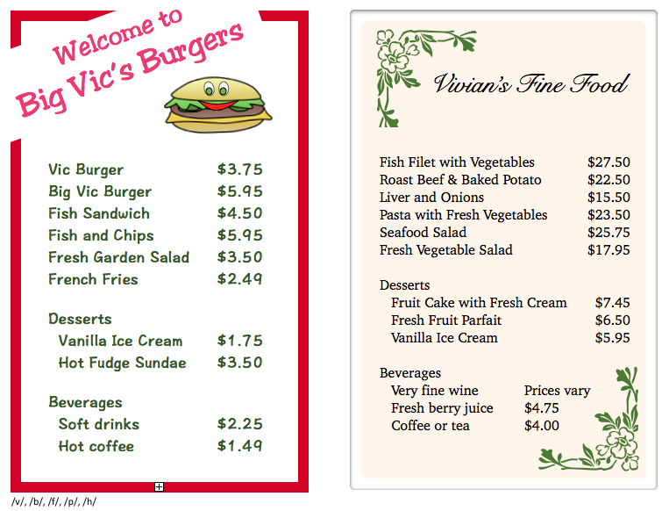
Communicative practice

Slide 18

The musical aspects of pronunciation
  Pronunciation is more than just sounds.
  For example, learners also need to know about:
  Syllables and word stress
  Thought groups and pauses
  Prominence and intonation
  Connected speech

Slide 19

We can practice these in many ways:
Through sight, sound, movement,
and meaningful activities

Slide 20
Syllables and word stress
How many syllables do these words have?
How many might learners think they have?
cat
responsibility
spring
chocolate

Slide 21
Syllables and word stress
How many syllables do these words have?
How many might learners think they have? Why?
cat cat 1
responsibility re•spon•si•bi•li•ty 6
spring spring 1
chocolate choc•olate 2 (generally)
/

Slide 22



Teaching word stress
When you teach new vocabulary, count syllables and practice stress patterns.
Mark word stress with movement: Clap, tap, stomp, or nod. Open and close your hand. Stretch a rubber band.

Slide 23

Build syllable models
TEACH er
con gra tu LA tions

Slide 24
Thought groups
Pausing between meaningful chunks of words makes speech easier to understand. These chunks are called “thought groups.”
You can lead a horse to water, /
but you can’t make him drink.

Slide 25
Prominence
In each thought group, there’s usually one prominent word that’s stressed more than the rest.
Often it’s the last content word.
You can lead a horse to water, /
but you can’t make him drink.

Slide 26
Prominence can change meaning.
You can lead a horse to water.
You can lead a horse to water.
You can lead a horse to water.
You can lead a horse to water.
You can lead a horse to water.

Slide 27
Mark prominence with movement
Punch the air, tap, or stomp
Stretch your hands apart or
stretch a rubber band
Nod your head or bend your knees

Slide 28
Intonation
Intonation is the up-and-down melody of your voice as you speak.
You can lead a horse to water, /
but you can’t make him drink.

Slide 29
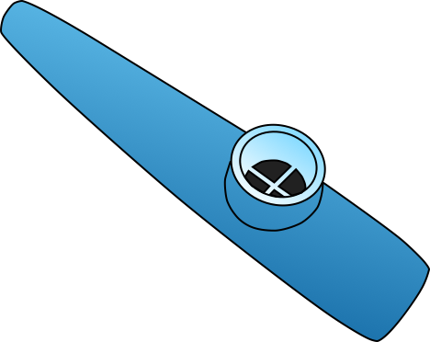
Ways to practice intonation
Make a pipe-cleaner model
Make a human intonation model
Conduct an intonation orchestra
Imitate intonation with a kazoo,
or just hum

Slide 30
Connected Speech
We don’t speak in strings of separate words:
Spoken words are like magnets, all stuck together:

Slide 31
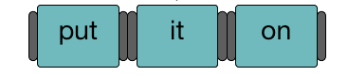
Raise awareness of connected speech
Connect magnets or blocks with Velcro on the end
Grasp hands together
Use dictations to practice interpreting connected speech

Slide 32
Dictations to practice connected speech
Where do you want to have lunch?
Would you like soup or salad with that?
    What words were hard for you to hear?
    Why do you think they were hard to hear?
Notes:
Where do you want to have lunch? Would you like soup or salad with that?

Slide 33
Dictations to practice connected speech
Where do you want to have lunch?
Would you like soup or salad with that?
    What words were hard for you to hear?
    Why do you think they were hard to hear?

Slide 34
Meaningful, communicative activities
Shadowing
Drama and role plays
Storytelling and creative projects

Slide 35
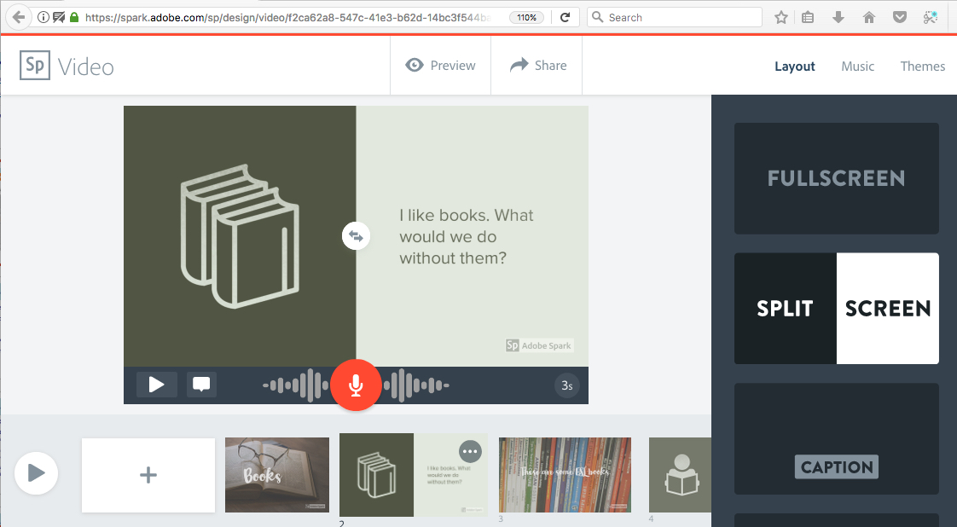
Creative pronunciation projects
Adobe Spark https://spark.adobe.com/ or as an app

Slide 36
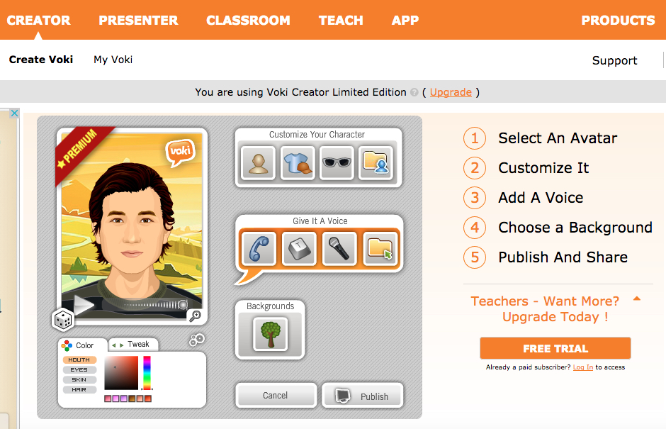
Creative pronunciation projects
Voki http://www.voki.com/ or as an app

Slide 37
Questions?

Slide 38
Contact Information
Thank you for listening. Let me know if you have any questions or comments:
          Marla Yoshida
          yoshidam@uci.edu
          http://teachingpronunciation.weebly.com
          Beyond Repeat After Me: Teaching Pronunciation to English Learners
          TESOL Press

