Slide 1
Pronunciation Boot Camp:
Teaching the Musical Aspects
of Pronunciation
Marla Yoshida
UC Irvine Extension • International Programs
TESOL Convention & Expo • Baltimore, Maryland
April, 2016

Slide 2
The musical aspects of pronunciation:
Syllables and word stress
Rhythm
Thought groups
Prominence
Intonation
Connected speech.

Slide 3


We can practice the musical aspects of pronunciation using sight, sound, movement, and authentic materials.

Slide 4
Syllables and word stress
How many syllables do these words have?
How many might your students think they have?
cat
table
imitation
spring
chocolate

Slide 5
Syllables and word stress
How many syllables do these words have?
How many might your students think they have?
cat 1
ta•ble 2
i•mi•ta•tion 4
spring 1
choc•olate 2 (generally)

Slide 6
How are stressed syllables different?
They can be longer
louder
higher in pitch
and they have a clearer vowel sound.

Slide 7
Mark the stressed syllable with movement
Clap, tap, stomp, or nod
Stand up
Open your eyes wider
Stretch a rubber band (if you trust your students not to get into trouble with it!)

Slide 8
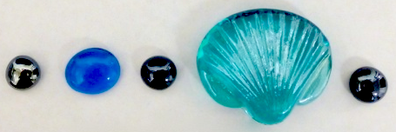
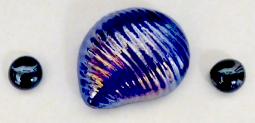
Syllable models

Slide 9
Make a syllable model of these words:
refrigerator
strong
imitate
imitation

Slide 10
Make a syllable model of these words:
re•fri•ge•ra•tor
strong
i•mi•tate
i•mi•ta•tion

Slide 11
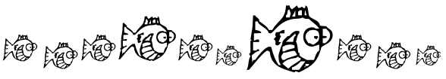
Rhythm
English has a rhythm like this:
Many other languages have a rhythm like this:

Slide 12
Clap to the rhythm
KIDS SANG SONGS.
The KIDS SANG some SONGS.
The CHILDren have SUNG a few SONGS.
The CHILDren might have been SINGing some SONGS.

Slide 13
Chants, poems, and rhymes
What’s for dinner?
What’s for dinner?
Soup and salad
Bread and butter
Cake and ice cream for dessert.
Set the table!
Set the table!
Plates and glasses
Forks and spoons
Now we’re ready. Let’s all eat!

Slide 14
Chants, poems, and rhymes
Humpty Dumpty sat on a wall.
Humpty Dumpty had a great fall.
All the king’s horses and all the king’s men
Couldn’t put Humpty together again.

Slide 15
Thought groups
I’ve learned that people will forget what you said, people will forget what you did,
but people will never forget how you made them feel.
(Maya Angelou)
/
/
/
/

Slide 16
Mark thought groups with movement
Hold up red and yellow cards for longer or shorter pauses.
Chop the air
between thought groups

Slide 17
Prominence
I want to learn English
but I don’t want to do any homework.
/
/

Slide 18
Prominence
I want to learn ENGlish
but I don’t want to do any HOMEwork.
/
/

Slide 19
Prominence can change meaning
Tom didn’t do his HOMEwork.
TOM didn’t do his homework.
Tom DIDN’T do his homework.
Tom didn’t do HIS homework.

Slide 20
Mark the prominent word with movement
Punch the air, tap, or stomp
Stretch your hands apart or stretch a rubber band (again, if you trust your students)

Slide 21
Intonation
I want to learn ENGlish
but I don’t want to do any HOMEwork.
/
/

Slide 22
Practice intonation
Kazoo
Pipe cleaner
Human intonation model
Conduct an orchestra

Slide 23

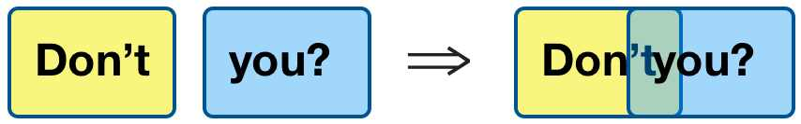
Connected Speech
→/nn/
→/t∫/

Slide 24
Find examples of connected speech:
I want to learn English,
but I don’t want to do any homework.
I told them they should have read the instructions before they put it together.

Slide 25
Find examples of connected speech:
I want to learn English,
but I don’t want to do any homework.
I told them they should have read the instructions before they put it together.
w
y

Slide 26
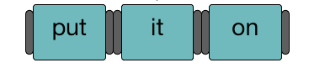
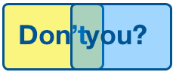
Mark connected speech with movement or tools
Grasp hands together
Connect magnets or blocks with Velcro on the ends.
Overlap words written on colored transparent plastic.

Slide 27
Dictations to practice connected speech
______________________________________
______________________________________
What words were hard for you to hear?
Why do you think they were hard to hear?

Slide 28
Dictations to practice connected speech
Where do you want to have lunch?
Would you like soup or salad with your meal?
What words were hard for you to hear?
Why do you think they were hard to hear?

Slide 29
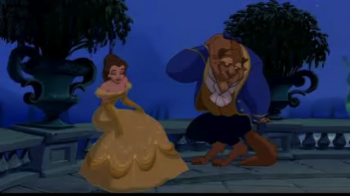
Watch and imitate a video clip. Try to sound exactly like the characters.
Shadowing
Beast: Belle, / are you / happy here with me?
Belle: Yes.
Beast: What is it?
Belle: If only I could see my father again,/ just for a moment. // I miss him so much!

Slide 30
How can you use some of these techniques in your teaching?

Slide 31
Marla Yoshida
yoshidam@uci.edu
Coming this summer from TESOL Press:
Beyond “Repeat After Me”:
An Essential Guide to Teaching Pronunciation
by Marla Yoshida

Slide 32
Questions?

Slide 33
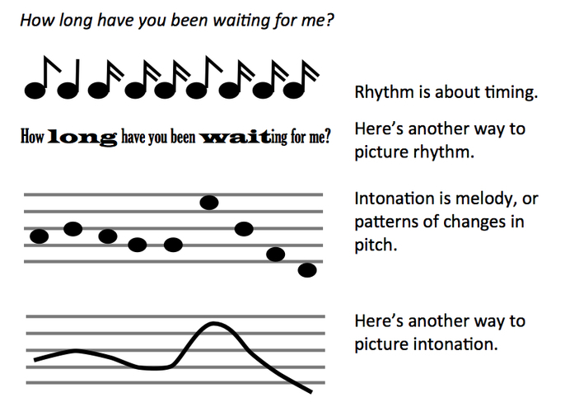
Intonation and rhythm are not the same.

Slide 34
Find examples of connected speech:
I want to learn English,
but I don’t want to do any homework.
I told them they should have read the instructions before they put it together.
w
y

