Slide 1
Making a Dental Model
Marla Yoshida
UC Irvine Division of Continuing Education
International Programs

Slide 2
You’ll need these materials:
A base for the roof and bottom of the mouth, such as a large bowl made of flexible plastic or a large bottle.
Material for teeth. Lightweight, air-hardening clay such as Crayola’s Model Magic works best.
Material for gums and alveolar ridge. A strip of flexible foam material, such as a piece of a “pool noodle” works well.

Slide 3
You’ll need these materials:
Two fasteners to hold the top and bottom sections together, such as cable ties, wire, or small bolts.
Glue that works for the materials you’ve chosen.

Slide 4
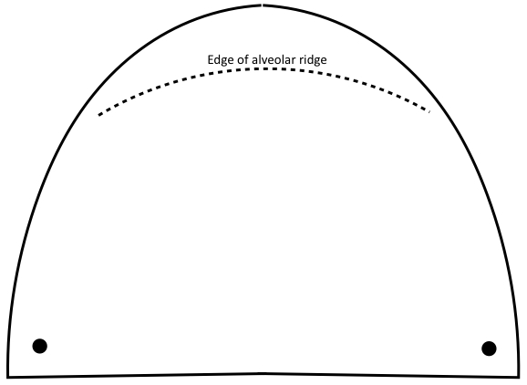
First, enlarge or reduce the pattern to fit the base material you’ve chosen. Trace the pattern twice on the base material.

Slide 5
Cut out the pieces with strong scissors or tin snips. Pierce or drill holes at the dots.

Slide 6
Connect the two pieces using nuts and bolts, cable ties, or wire. (You can do this step last if you want.

Slide 7
For the gums, cut two strips of foam or shape strips of clay long enough to fit around the front curve of the jaws.

Slide 8
Glue the strips in place. They’ll be a base for attaching the teeth.

Slide 9
This is what the strips look like from the back.

Slide 10
Cut out a curved piece of foam or shape clay for the alveolar ridge. Glue it just behind where the front top teeth will be.

Slide 11
Shape or cut teeth and glue in place. Start from front center and work backwards.

Slide 12
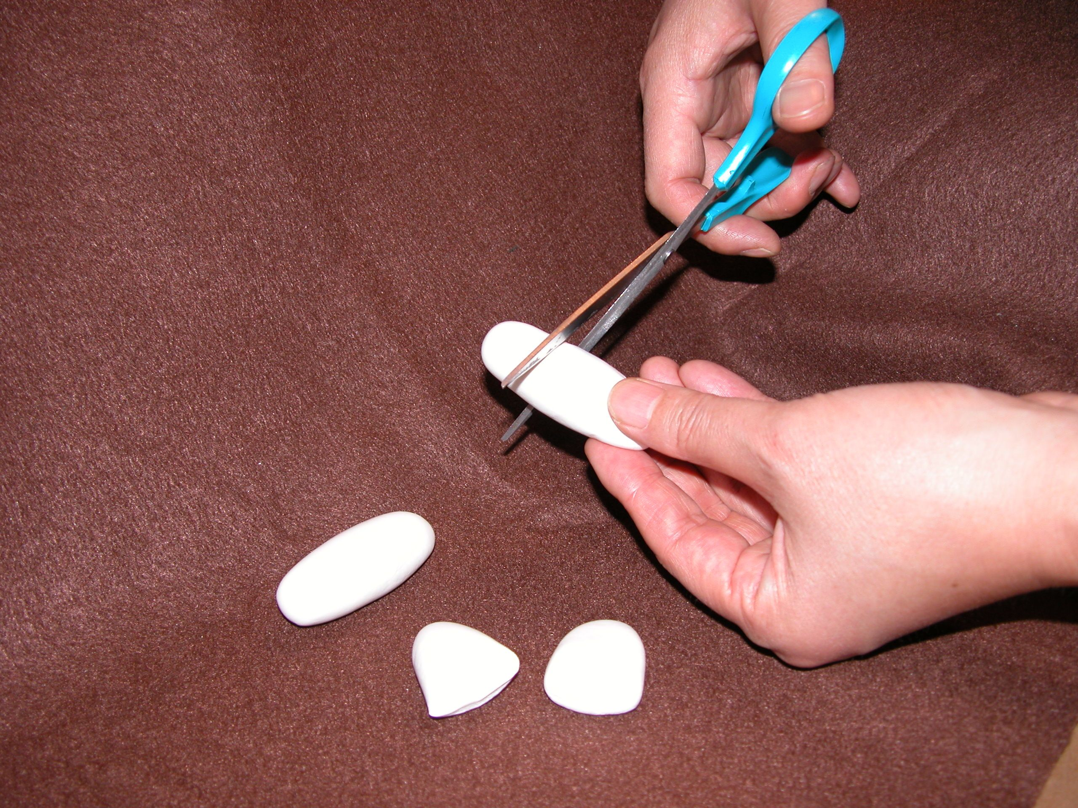
If you’re using clay, form a rolled shape big enough for two teeth, then cut it in half with scissors to get a good basic tooth shape.

Slide 13
Flatten the top of the tooth against the gums with lots of overlap for strength. For molars, make teeth deeper and shape indentations with a toothpick, stick, or similar tool.

Slide 14
Finish gluing all the teeth in place.

Slide 15
The finished model.

