Slide 1
Low-Tech, Low-Cost Gadgets for Your Pronunciation Toolbox
Marla Yoshida• yoshidam@uci.edu http://teachingpronunciation.weebly.com
UC Irvine Division of Continuing Education
International Programs
TESOL International Convention• March, 2017

Slide 2
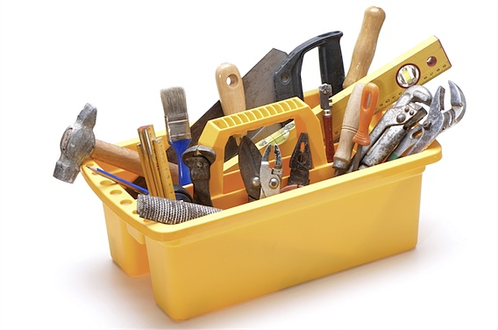
Why do you need pronunciation tools?
Teaching pronunciation, like any craft, works better if you have the right tools.

Slide 3
Why do you need pronunciation tools?
Show, don’t just tell.
Students learn best when material is presented in many different ways.

Slide 4
Why do you need pronunciation tools?
You don’t have to spend a lot of money on tools!
Here are my favorite (cheap) gadgets from my pronunciation toolbox

Slide 5


Glass blobs, beans, etc.
With large and small shapes, students form syllable and stress patterns for words.
What words could these patterns represent?

Slide 6
Pipe cleaners
Model the intonation of sentences.
Cheaper: Use string or strips of paper
Try it:
Pronunciation is important.
Is pronunciation important?
Why is pronunciation important?

Slide 7

Drinking straws
To practice intonation, use a straw as a baton to “conduct an orchestra.”
Encourage lip rounding for /w/, /kw/,and/uw/.

Slide 8
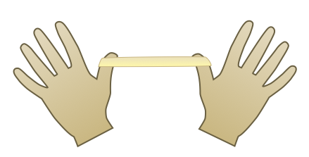
Rubber bands
Stretch a thick rubber band to practice:
word stress
prominence
tense and lax vowels

Slide 9

Rubber bands
Even cheaper: Clasp hands tightly

Slide 10

Balloons
Model how the lungs and vocal cords work to illustrate voiced and voiceless sounds.

Slide 11
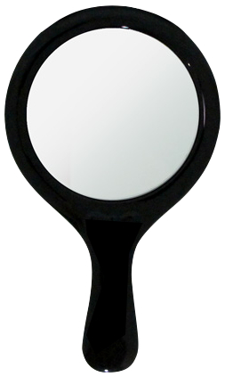
Mirrors
Let students see what their mouths are doing
Cheaper for you:
Have students use cell phones to see themselves

Slide 12
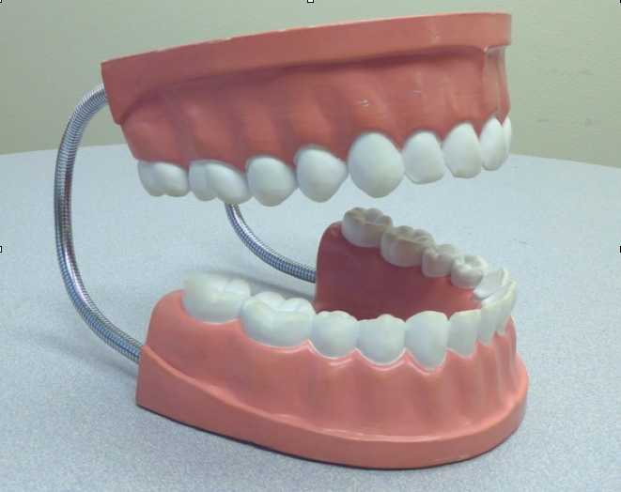
Dental Model
Show what’s happening inside the mouth

Slide 13
Dental Model
Cheaper:
Make your own.

Slide 14
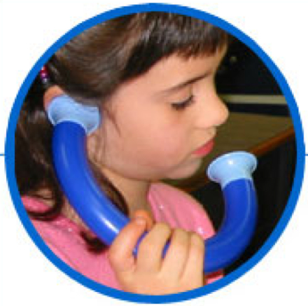
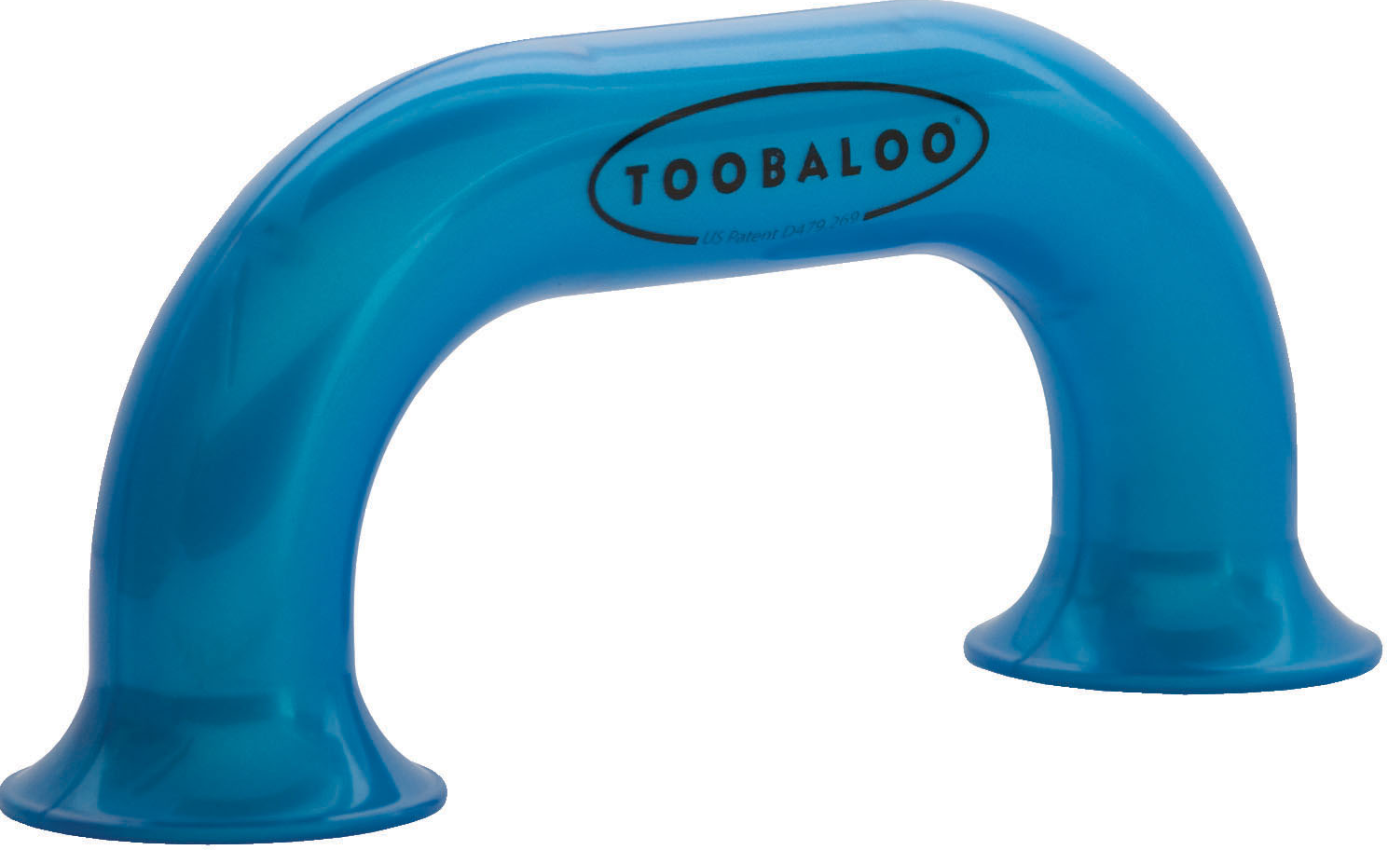
Listening tubes
Students can hear their own voices more clearly while background noise is blocked out.

Slide 15
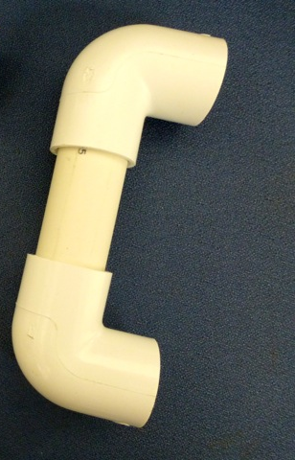
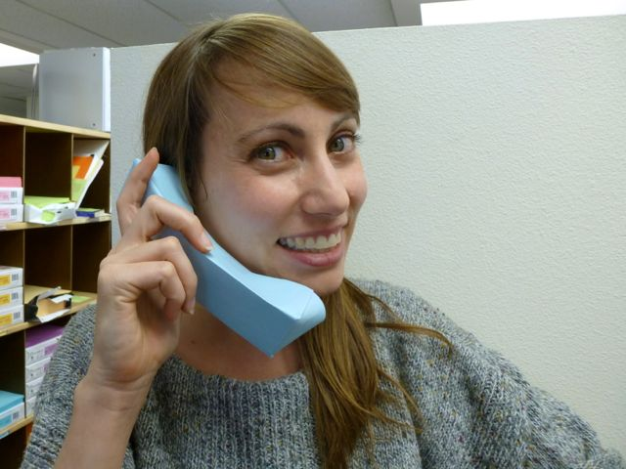
Listening tubes
Cheaper: Make your own from PVC pipe or heavy paper.
“Paper Phone” Instructions

Slide 16
For more ideas:
Check craft stores, toy stores, party supply stores, building supply stores, your garage, junk drawer, or kids’ toy box for unrecognized treasures.
Beyond Repeat After Me: Teaching Pronunciation to English Learners. TESOL Press, 2016.
Source list for dental models & listening tubes: http://teachingpronunciation.weebly.com/pronunciation-supplies.html

Slide 17
Use your imagination!
Many ordinary items can be
creative additions to your
pronunciation teaching toolbox!

Slide 18
Questions?

Slide 19
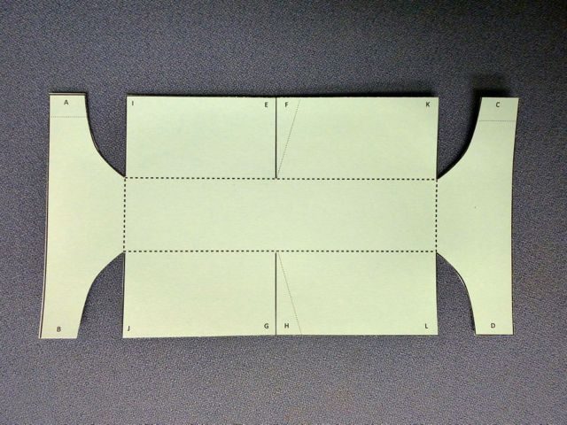
1. Cut the pattern out of heavy paper.

Slide 20
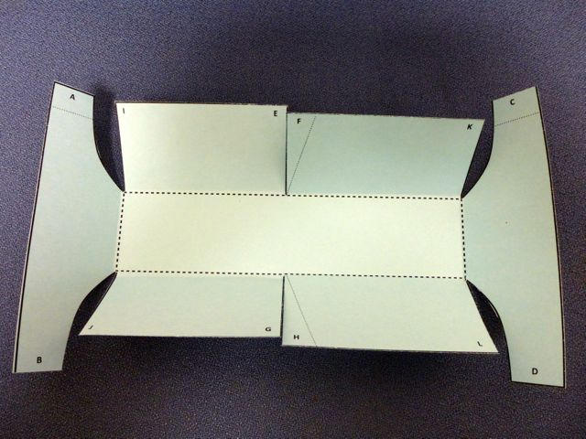
2. Fold up on the heavy dotted lines.

Slide 21
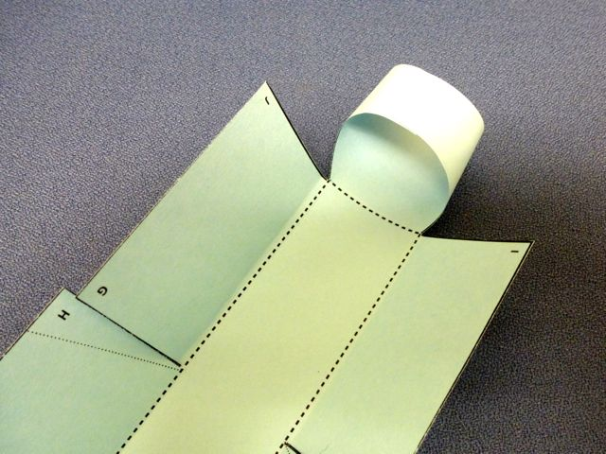
3. Roll and tape the ends.

Slide 22
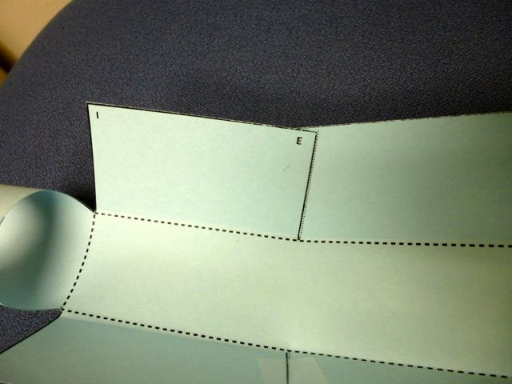
4. Overlap and tape the center section.

Slide 23
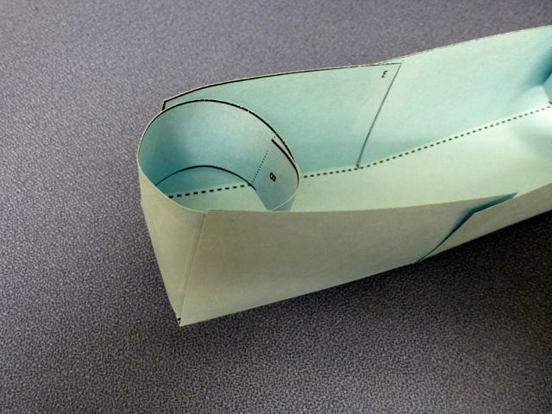
5. Fold up the sides and tape them to the rolls at the ends.

Slide 24
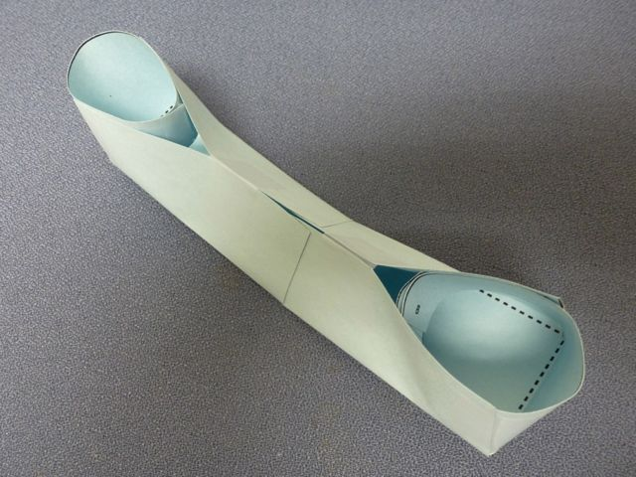
6. The finished “paper phone.”
Return to gadgets

