Slide 1
Introduction to Teaching Pronunciation
UCI Extension TEFL Programs
TEFL Workshop • June 27, 2012
Marla Yoshida
http://teachingpronunciation.weebly.com

Slide 2
What do you need to know when you teach pronunciation?
You need to know about pronunciation.
You need to understand the problems your students might have.
You need to know how to teach these things to your students and help them practice effectively.

Slide 3
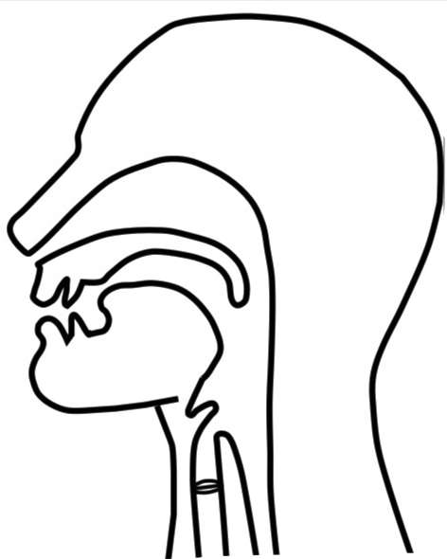
The Articulatory System
Lips
Teeth
Tongue
Alveolar ridge (tooth ridge/gum ridge)
Hard palate
Soft palate (velum)
Nasal passage
Jaw
Vocal cords
Trachea (wind pipe)

Slide 4
Consonants: • Voicing • Place of Articulation • Manner of Articulation

Slide 5
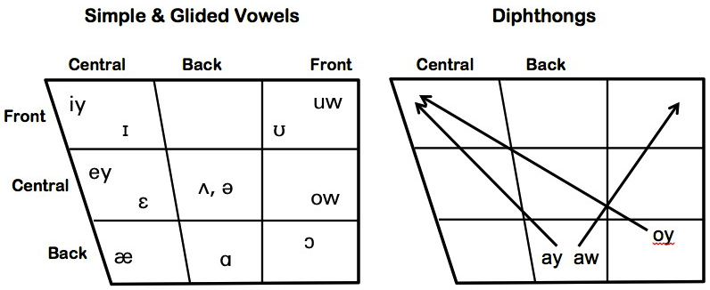
Vowels:
Tongue position
Lip rounding
Tense vs. lax
Simple vowels, glided vowels, and diphthongs

Slide 6
How can we teach pronunciation effectively?
We need to do more than simply teach rules and use mechanical drills.
Individual sounds vs. the musical aspects of pronunciation (Intonation, stress, rhythm)
Simple repetition is fine, but we also need meaningful or communicative activities
Use a wide range of techniques and activities.

Slide 7
Pronunciation practice activities

Slide 8
Pronunciation practice activities: Info gap

Slide 9
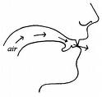
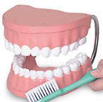
Multisensory reinforcement techniques
Visual: Let students see how to pronounce sounds through
• pictures and diagrams
• demonstrations (live/on video)
• models (like giant teeth)
• phonemic alphabets
• colors to represent sounds

Slide 10
Multisensory reinforcement techniques
Auditory: Use the sense of hearing.
• Choral and individual repetition
• Memory pegs: an image or phrase connected to the sound

Slide 11
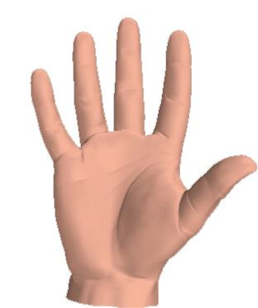
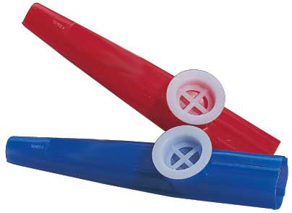
Multisensory reinforcement techniques
Tactile: Use the sense of touch.
Stretch rubber bands to represent word stress.
A feather shows aspiration of stops.
Hand on throat to feel the vibration of the vocal cords
Play a kazoo to feel intonation patterns

Slide 12
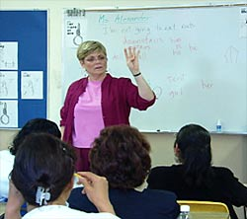
Multisensory reinforcement techniques
Kinesthetic: Hand and body movements to help learners understand how pronunciation works.
Body movements can be used to represent sounds and suprasegmental features.
Marsha Chan: Using Your Hands to Teach Pronunciation
Millicent Alexander: Pronouncercizing

Slide 13
Drama Techniques
Plays, skits, role plays, puppets
Many students feel more comfortable trying out new sounds or intonation patterns when they’re pretending to be someone else.

Slide 14
Students watch a video clip, then practice the dialog, trying to sound exactly like the characters.
Shadowing and Mirroring
Beast: Belle, / are you / happy here with me?
Belle: Yes.
Beast: What is it?
Belle: If only I could see my father again,/ just for a moment. // I miss him so much!

Slide 15
Use your imagination to find new ways to teach pronunciation communicatively and effectively.
For more ideas and tutorials on teaching pronunciation:
http://teachingpronunciation.weebly.com

Slide 16
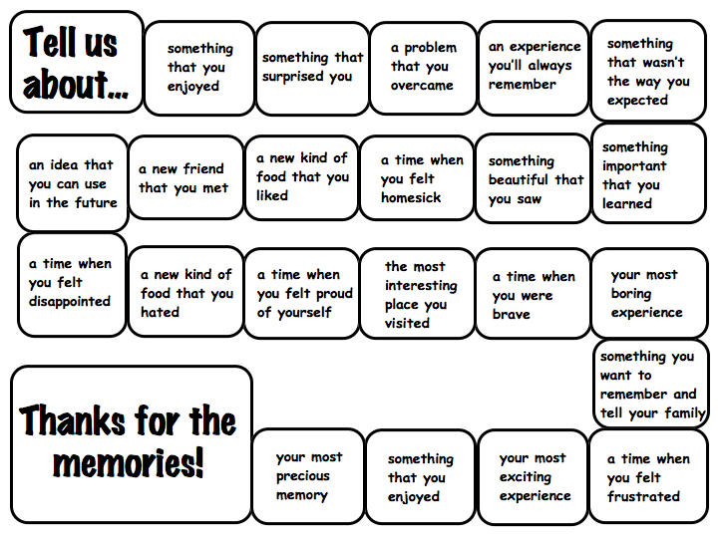
Try using games that get students to speak freely. (“Lace” them with sounds you want to practice.”)
Pronunciation games for fluency

Slide 17
Using authentic materials
Songs
Poetry, rhymes, and chants
Advertisements, menus, and pictures
Cartoons
Magazines and newspapers
Video clips from movies, TV programs, YouTube, or other online sources
Stories, plays, and other literature

