Slide 1
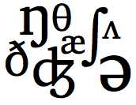
Beyond “Repeat After Me”:
Teaching Pronunciation with Imagination
Marla Yoshida
UC Irvine Extension • International Programs
Orange County CATESOL Workshop
November 8, 2014
http://teachingpronunciation.weebly.com

Slide 2
What do you think?
Agree? Disagree? Not sure?
It’s extremely important for students to try to pronounce English like a native speaker.

Slide 3
What do you think?
Agree? Disagree? Not sure?
There are two forms of English pronunciation: American English and British English.

Slide 4
What do you think?
Agree? Disagree? Not sure?
If students learn to produce all the sounds of English correctly, they will have good pronunciation.

Slide 5
What do you think?
Agree? Disagree? Not sure?
There are many ways to teach pronunciation, involving different senses and learning modalities.

Slide 6
Some basic principles
A realistic goal: Easy intelligibility rather than sounding exactly like a native speaker.
Both sounds (segmentals) and the musical aspects of pronunciation (suprasegmentals) are necessary to make speech intelligible.
Do more than just “repeat after me.” Use many ways of teaching and practicing: Hearing, seeing, touching, moving.

Slide 7
The Sounds of American English
Letters are not sounds. Sounds are not letters.
Consonants: They bump, slide, hiss, or pop.
big map see use
What consonant sounds cause the most trouble for your students?
Why do you think they have trouble with these sounds?

Slide 8
The Sounds of American English
Vowels: They flow out smoothly.
apple east out hour
Pop quiz: How many vowel sounds are there in American English?
Five, or sometimes six.
Thirteen or fourteen.
Nobody really knows. Vowel sounds are slippery little critters.

Slide 9
A Step-by-Step Approach to Teaching Sounds
Introducing a new sound (Description & analysis)
Listening discrimination
Practice: From controlled to guided to communicative practice

Slide 10
Introducing Sounds
Help students understand and feel how to pronounce the sound
Explain, demonstrate, or use visual aids
Choose the method that best fits your students: Age, proficiency level, preferences

Slide 11





Introducing Sounds: Tools

Slide 12
Listening Discrimination
Students need to learn to hear the difference between sounds.
Listen to authentic materials using real connected speech, not just overly careful individual words.

Slide 13
Listening Discrimination: Minimal Pairs
very berry
marvel marble
curve curb
Same or different?
Which one is different?
Which one am I saying?

Slide 14
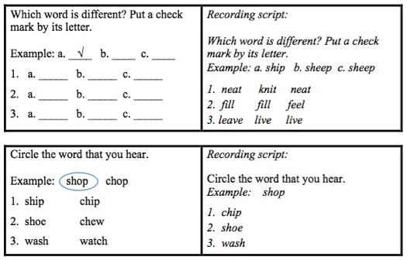
Listening Discrimination: Activities

Slide 15
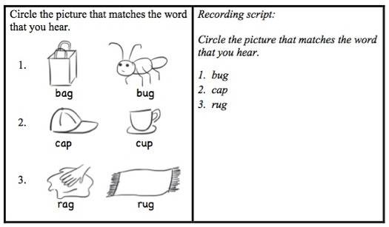
Listening Discrimination: Activities

Slide 16
Listening Discrimination: Activities

Slide 17
Practicing Sounds: Controlled Practice
Lisa: I wish I had a driver’s license. I’m so tired of taking the bus or asking my friends for a ride.
Rob: Me too. Every time I want to go to the store I have to ask my roommate to take me.
Lisa: Your roommate has a car? You’re so lucky!
Rob: I know. He says he doesn’t mind giving me a lift, but I don’t like to bother him.
Lisa: I know what you mean. I don’t like to be a burden on my friends, either.

Slide 18
Practicing Sounds: Controlled Practice
Tongue Twisters:
The three trees
Funny Frank fell fifty feet.
Betty loves the velvet vest best.
She sells seashells by the seashore.
The sixth sheik’s sixth sheep’s sick.
TOO HARD!

Slide 19
Practicing Sounds: Guided Practice

Slide 20
Practicing Sounds: Guided Practice

Slide 21
Practicing Sounds: Communicative Practice

Slide 22
Practicing Sounds: Communicative Practice

Slide 23
Suprasegmentals:
The Musical Aspects of Pronunciation
Syllables and word stress
Rhythm
Thought groups and prominence
Intonation
Connected speech

Slide 24
Syllables and Word Stress
Stressed syllables can be…
longer
louder
higher in pitch
and they have a clear vowel sound.

Slide 25
Syllables and Word Stress

Slide 26
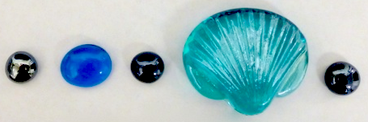
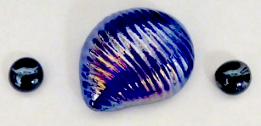
Syllables and Word Stress
Practice representing syllable patterns of words.
Try these words:
table
imagination
strong
electric
electricity

Slide 27

Rhythm
English has stress-timed rhythm:
Many other languages have syllable-timed rhythm:

Slide 28
Rhythm: Clap to the rhythm
CAKE TASTES GOOD.
The CAKE TASTED GOOD.
The CAKE might have TASTED GOOD.
The CAKE must have TASTED deLIcious.
The CAKE shouldn’t have TASTED so deLIcious.

Slide 29
Rhythm: Chants and rhymes
What’s for dinner?
What’s for dinner?
Soup and salad
Bread and butter
Cake and ice cream for dessert.
Set the table!
Set the table!
Plates and glasses
Forks and spoons
Now we’re ready. Let’s all eat!

Slide 30
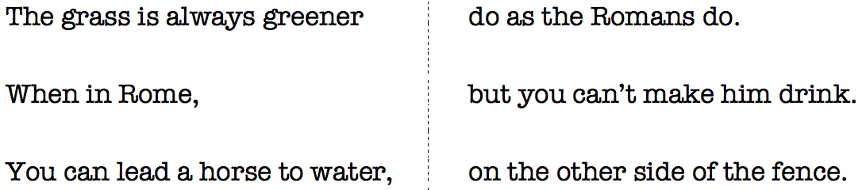
Thought Groups and Prominence
If you talk too quickly, it’s hard to understand you.

Slide 31
Practicing pauses between thought groups
“I’ve learned that people will forget what you said, people will forget what you did, but people will never forget how you made them feel.”
(Maya Angelou)
Boyfriend: What’s your favorite music group?
Girlfriend: I love U2!
Boyfriend: I love you too, but what’s your favorite music group?

Slide 32
Intonation
If you talk too quickly, it’s hard to understand you.

Slide 33
Practicing intonation
Boyfriend: What’s your favorite music group?
Girlfriend: I love U2!
Boyfriend: I love you too, but what’s your favorite music group?
Statements: I love U2.
Yes/No questions: Do you like U2?
WH questions: Why do you like U2?
Or questions: Do you like U2 or the Beatles?

Slide 34

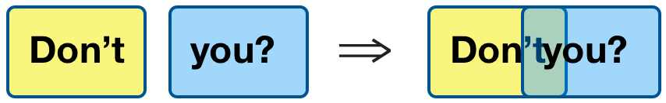
Connected Speech
→/t∫/

Slide 35
Connected Speech: Dictations
Where do you want to have lunch?
I’ll get you a menu.
Would you like soup or salad with your meal?
What words were hard for you to hear?
Why do you think they were hard to hear?

Slide 36
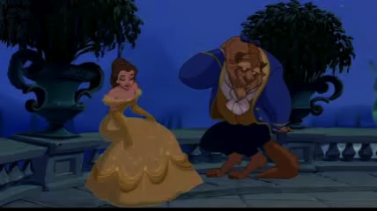
Watch and imitate a video clip. Try to sound exactly like the characters.
Shadowing and Mirroring
Beast: Belle, / are you / happy here with me?
Belle: Yes.
Beast: What is it?
Belle: If only I could see my father again,/ just for a moment. // I miss him so much!

Slide 37
How can we find time for pronunciation?
Combine short bits of noticing and practicing pronunciation during all parts of your lesson.
When starting or ending a lesson:
Do some quick review with flash cards, minimal pairs, or a tongue twister.
Sing a song with the sounds or connected speech that you want to practice.

Slide 38
How can we find time for pronunciation?
When teaching vocabulary:
Pay attention to the pronunciation and stress pattern of new words.
Notice how sound relates to spelling.
Let students hear new words in natural contexts, not just as careful, individual words.
Review the pronunciation of vocabulary words often.

Slide 39
How can we find time for pronunciation?
When teaching reading:
Have students read quietly to themselves or to a partner. Listening tubes are helpful.
Avoid “cold” reading aloud. Give students time to hear and quietly practice the passage first.
When reading aloud, keep it short and easy to understand.
Encourage students to think about pausing and intonation as they read.

Slide 40
How can we find time for pronunciation?
When teaching speaking:
In communicative activities, include words and sounds that you want to practice. Draw attention to these when you give instructions.
Emphasize thought groups, prominence, and intonation.

Slide 41
How can we find time for pronunciation?
When teaching listening:
Give students focused practice in listening to reduced and connected speech.
Help students use context clues to figure out what sounds and words they’re hearing.

Slide 42
How can we find time for pronunciation?
When teaching grammar:
Practice the sounds of grammatical forms, not just their written forms: going to, want to, should have.
Help students hear the difference between can and can’t, are and aren’t, were and weren’t.
Practice the pronunciation of –s and –ed endings.
When teaching questions, practice the intonation pattern that goes with each question type.

Slide 43
Use your imagination to find new ways
to teach pronunciation!
For more ideas and tutorials on teaching pronunciation:
http://teachingpronunciation.weebly.com

Slide 44
Questions?

Slide 45
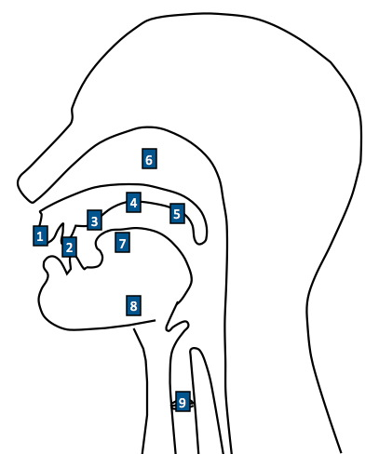
The Articulatory System
Lips
Teeth
Alveolar ridge (tooth ridge/ gum ridge)
Hard palate (roof of the mouth)
Soft palate (velum)
Nasal passage
Tongue
Jaw
Vocal cords

Slide 46
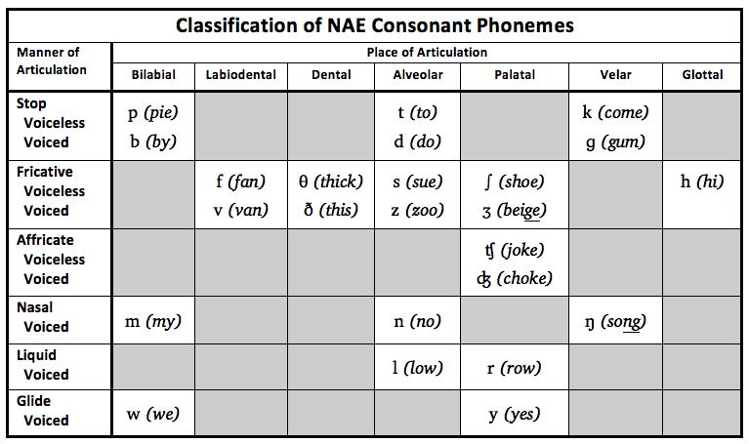
Consonants: • Voicing • Place of Articulation • Manner of Articulation

Slide 47
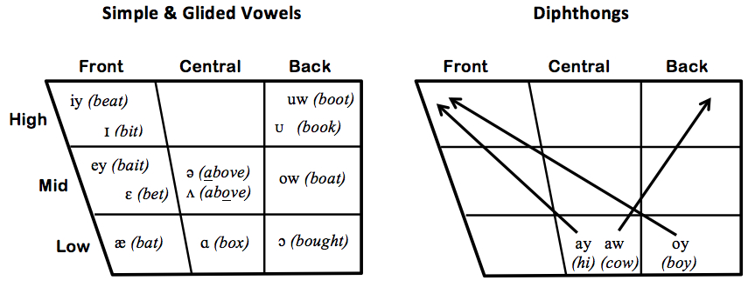
Vowels:
Tongue position
Lip rounding
Tense vs. lax
Simple vowels, glided vowels, and diphthongs

