Slide 1
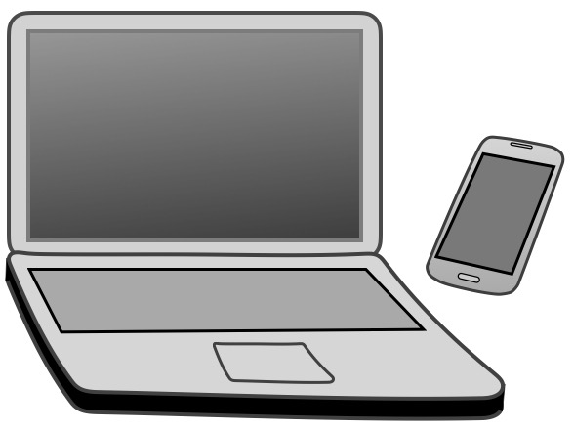
Which Tech Tools Will Help Me
Reach My Pronunciation Goals?
Marla Yoshida
University of California, Irvine
Division of Continuing Education
yoshidam@uci.edu
teachingpronunciation.weebly.com

Slide 2
What should you think about in choosing pronunciation teaching technology?
Goals
Quality and accuracy
Practicality
Cost

Slide 3
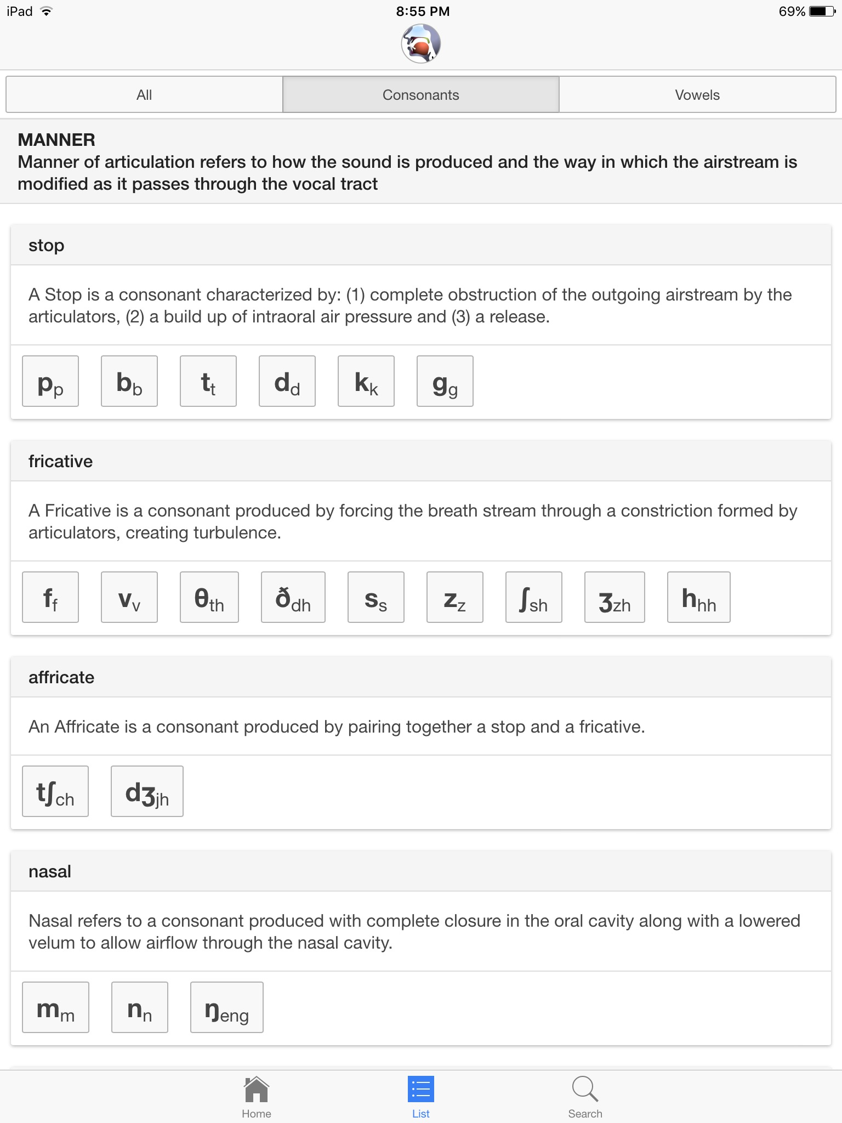
Goal: Provide a pronunciation model
Sounds of Speech (University of Iowa Phonetics) http://soundsofspeech.uiowa.edu

Slide 4
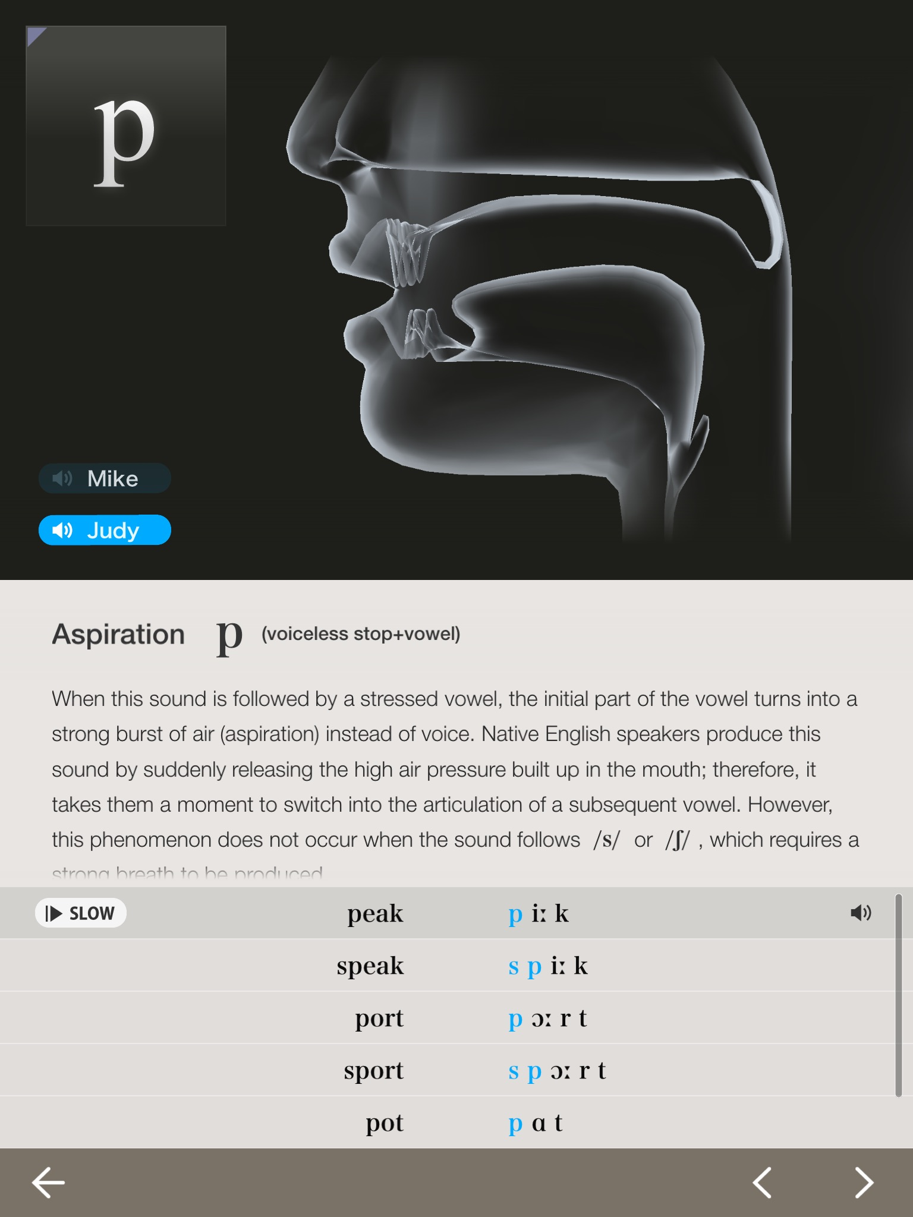
Goal: Provide a pronunciation model
The Phonetics (app)
Apple App Store. Search for “The Phonetics Interactive 3D models of oral visualization”

Slide 5
Goal: Provide a pronunciation model
The Phonetics

Slide 6
Goal: Provide a pronunciation model
Online dictionaries and apps
Merriam-Webster Learner’s Dictionary (American English): http://learnersdictionary.com/
Longman Dictionary of Contemporary English Online (Both British and American English): http://www.ldoceonline.com/
Oxford Learner’s Dictionary (Both British and American English): http://www.oxfordlearnersdictionaries.com/us/
Cambridge Dictionary (Both British and American English): http://dictionary.cambridge.org/

Slide 7
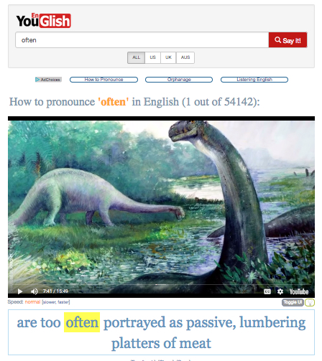
Goal: Provide a pronunciation model
YouGlish.com:
A contextualized pronunciation dictionary
https://youglish.com
PlayPhrase:
Type in a phrase and watch numerous very short video clips of that phrase.
http://playphrase.me/

Slide 8
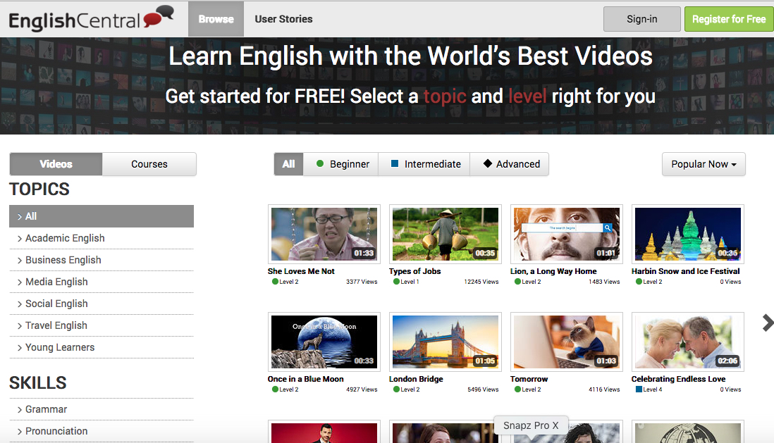
Goal: Provide a pronunciation model
EnglishCentral: http://englishcentral.com/videos

Slide 9
Goal: Provide a pronunciation model
EnglishCentral: http://englishcentral.com/videos

Slide 10
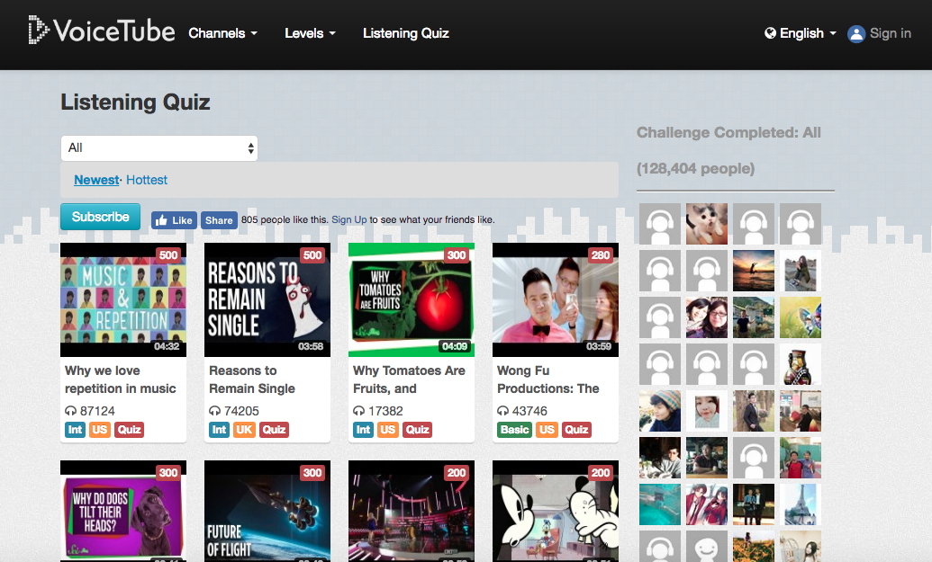
Goal: Provide a pronunciation model
Voicetube: http://voicetube.com

Slide 11
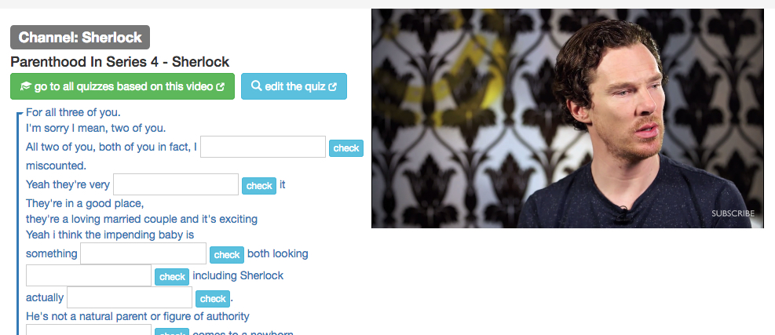
Goal: Provide a pronunciation model
TubeQuizard: http://tubequizard.com/

Slide 12
Goal: Provide a pronunciation model
VOA News Learning English: http://learningenglish.voanews.com/
TED Talks (http://www.ted.com)
National Public Radio (http://www.npr.org)
The British Broadcasting Corporation (BBC) (http://bbc.co.uk)
YouTube (http://youtube.com)

Slide 13
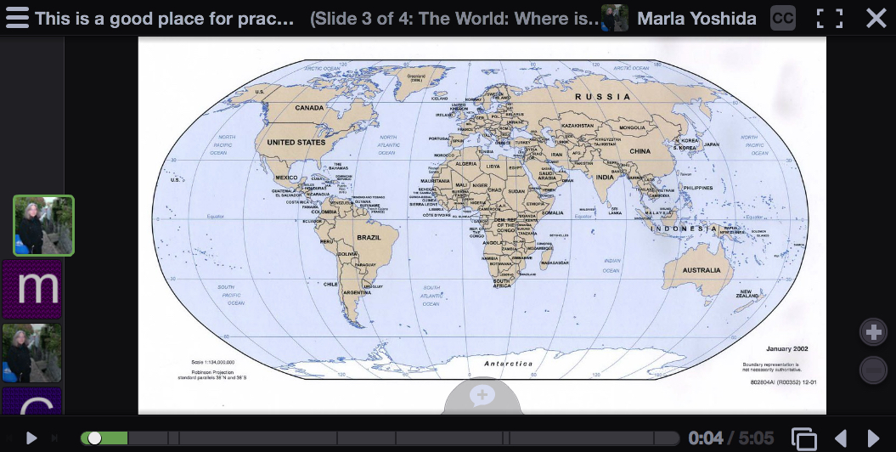
Goal: Record pronunciation practice
Cell phones, computers, and tablets have built-in sound recording capability
Voicethread http://voicethread.com

Slide 14
Goal: Record practice creatively
Narrated PowerPoint or Keynote slideshows

Slide 15
Once there was a cow who wanted to travel.

Slide 16
So she walked to the other side of the pasture.

Slide 17
And then she walked back. And that’s all.

Slide 18
Goal: Record practice creatively
Adobe Spark https://spark.adobe.com

Slide 19
Goal: Record practice creatively
Puppet Pals (Apple App Store)

Slide 20
Goal: Record practice creatively
Voki http://www.voki.com

Slide 21
Goal: Practice pronunciation independently
Dictation in Word, Pages, Google Docs (on the Chrome browser), or other programs using ASR (Automatic Speech Recognition)

Slide 22
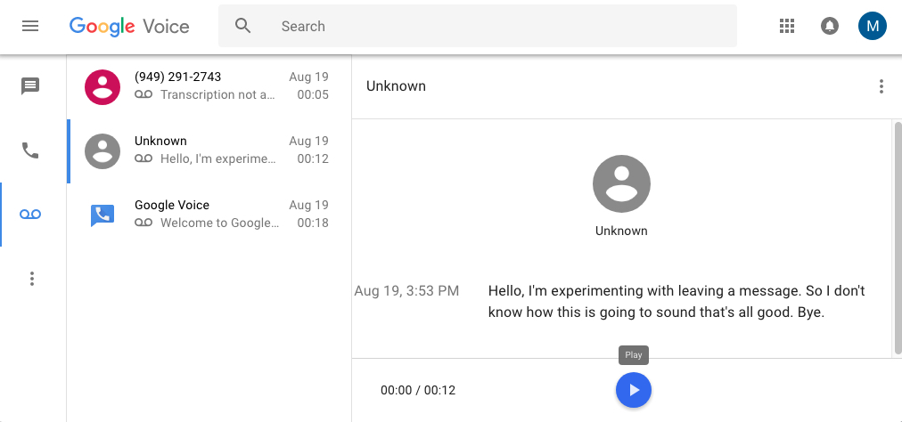
Goal: Practice pronunciation independently
Google Voice: Students leave recorded messages
(949) 297-6540

Slide 23
Goal: Practice pronunciation independently
Pronunciation teaching apps
Many apps say they analyze speech and rate its accuracy. Many don’t work very well.
If you’re thinking of using one, test it for yourself and make sure it does what you need.

Slide 24
Suggestions
Think outside the box. Some tools that were meant for other purposes are also useful for pronunciation practice.
Try out a tool before you commit yourself. Read the reviews and ask the opinions of colleagues. Don’t fall for advertising hype.
Use what works best for you and your students, not necessarily what seems newest or flashiest.

Slide 25
Contact Information
Marla Yoshida yoshidam@uci.edu
For further reading: Beyond Repeat After Me: Teaching Pronunciation to English Learners (TESOL Press)
“Choosing Technology Tools to Meet Pronunciation Teaching and Learning Goals” in the current edition of the CATESOL Journal: catesoljournal.org

Slide 26
Questions?

