Slide 1
Beyond Repeat After Me:
Teaching Pronunciation with Imagination
Marla Yoshida
UC Irvine Division of Continuing Education
TESOL International Conference 2017

Slide 2
Handouts and PowerPoint are here:
http://teachingpronunciation.weebly.com

Slide 3
Is being good at pronouncing English enough to make someone a good pronunciation teacher?
What else do we need?

Slide 4
We need to…
Gather ideas about how to teach pronunciation well.
Learn more about our students and their typical pronunciation problems.
Learn the facts about pronunciation. We can’t rely only on intuition.

Slide 5
Pop Quiz
Name an English sound that never comes at the beginning of an English word.
/ŋ/
Name an English sound that never comes at the end of an English word.
/h/

Slide 6
How can we do this?
Learn from colleagues: Share ideas, attend presentations.
Try out new ideas and share those that work well.
Read books and articles to get information and new ideas.

Slide 7
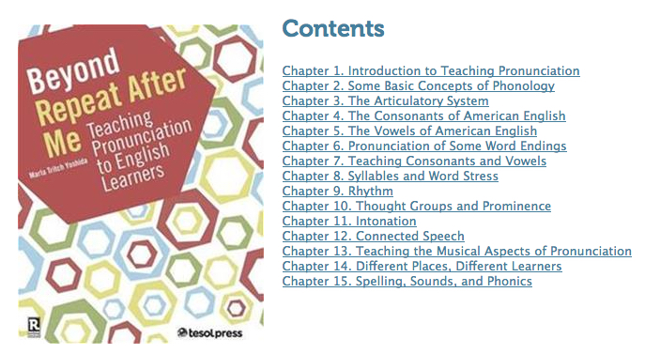
Learning the facts about pronunciation doesn’t have to be scary.

Slide 8
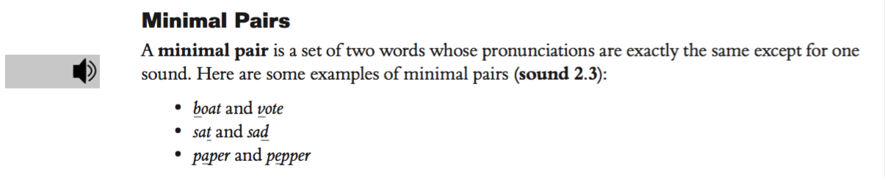

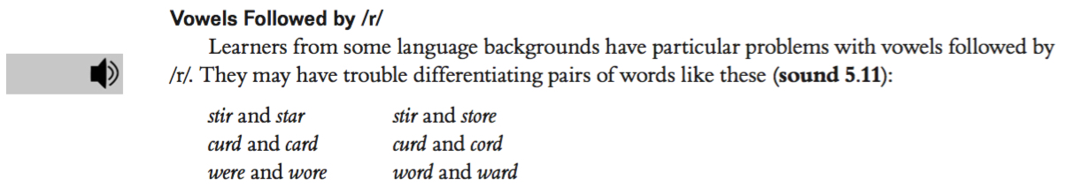
Audio and video files are on the website
http://www.tesol.org/read-and-publish/bookstore/beyond-repeat-after-me

Slide 9

Audio and video files are on the website
http://www.tesol.org/read-and-publish/bookstore/beyond-repeat-after-me

Slide 10
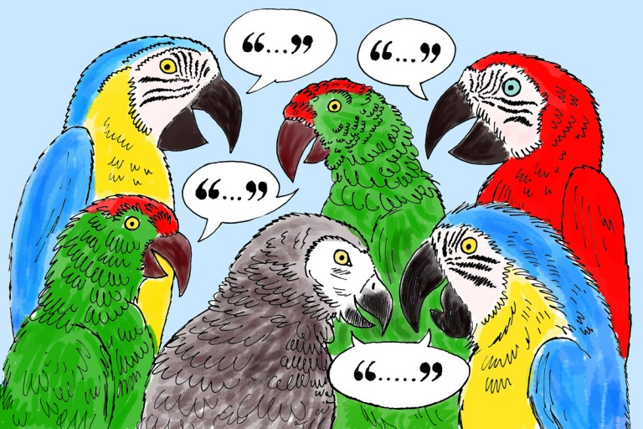
“Repeat after me” is useful, but it’s not enough for successful pronunciation teaching.
Use sight, movement, and meaningful activities.

Slide 11



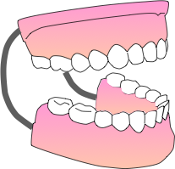

Sight

Slide 12





Movement: Practicing word stress
Try: classroom information volunteer

Slide 13


Movement: Connected speech
Try: Why can’t you run nine miles?

Slide 14

Movement: Thought groups & pauses
Try: When in Rome, do as the Romans do.

Slide 15

Movement: Prominence/sentence focus
Try: Grammar isn’t boring; it’s exciting.

Slide 16

Movement: Intonation
Try: Is today Wednesday? Yes, it is.

Slide 17
Meaningful activities:
A house plan with /l/ & /r/ words
How can you practice with it?

Slide 18
Meaningful
activities:
A menu with
/f/, /v/, /p/, &
/b/ words
How can you practice with it?

Slide 19
Never stop learning and finding new ways to teach pronunciation with imagination!

Slide 20

30% OFF at Convention Only!
Beyond Repeat After Me:
Teaching Pronunciation to ELs
Help guide your students toward more effective communication skills
Learn concrete ways to introduce and practice
pronunciation actively and communicatively, using sight, sound, and movement.
Includes online resources packed with pronunciation models, video and audio demonstrations, and practice activities!
Special TESOL Convention Price: US$33.55
Buy it today at the TESOL Press Bookstore in the Expo Hall

Slide 21
Book drawing
Look at the number in a circle in the lower right-hand corner on the last page of your handout.

Slide 22
Use sight: “Sammy diagrams”

Slide 23
Pop Quiz
True or false? If learners can say all the consonant and vowel sounds accurately, they’ll have good pronunciation.
Nope. There’s more to it than just sounds.

Slide 24
A simple info gap

Slide 25
A family tree with /r/ & /l/
How could you practice with it?

Slide 26
Meaningful activities

