Slide 1
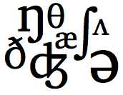
Pronunciation Workshop
UCI Division of Continuing Education
Marla Yoshida
http://teachingpronunciation.weebly.com

Slide 2
Is being good at pronouncing English enough to make someone a good pronunciation teacher?
What else do we need?

Slide 3
Gather ideas about how to teach pronunciation well.
Learn more about our students and their typical pronunciation problems.
Learn the facts about pronunciation. We can’t rely only on intuition.

Slide 4
Pronunciation includes
Sounds (consonants and vowels)
The musical aspects of pronunciation

Slide 5
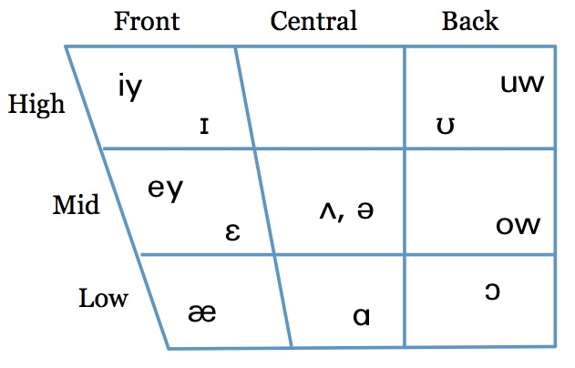
Language is messy.

Slide 6

Sounds are not letters.
Letters are not sounds.
s ≠

Slide 7
Vocal cords
Lips
Teeth
Alveolar ridge
Hard palate
Soft palate (velum)
Tongue
Jaw
Nasal cavity (nasal passage)

Slide 8
Vocal cords
Lips
Teeth
Alveolar ridge
Hard palate
Soft palate (velum)
Tongue
Jaw
Nasal cavity (nasal passage)

Slide 9
Vocal cords
Lips
Teeth
Alveolar ridge
Hard palate
Soft palate (velum)
Tongue
Jaw
Nasal cavity (nasal passage)

Slide 10
Vocal cords
Lips
Teeth
Alveolar ridge
Hard palate
Soft palate (velum)
Tongue
Jaw
Nasal cavity (nasal passage)

Slide 11
Vocal cords
Lips
Teeth
Alveolar ridge
Hard palate
Soft palate (velum)
Tongue
Jaw
Nasal cavity (nasal passage)

Slide 12
Vocal cords
Lips
Teeth
Alveolar ridge
Hard palate
Soft palate (velum)
Tongue
Jaw
Nasal cavity (nasal passage)

Slide 13
Vocal cords
Lips
Teeth
Alveolar ridge
Hard palate
Soft palate (velum)
Tongue
Jaw
Nasal cavity (nasal passage)

Slide 14
Vocal cords
Lips
Teeth
Alveolar ridge
Hard palate
Soft palate (velum)
Tongue
Jaw
Nasal cavity (nasal passage)

Slide 15
Vocal cords
Lips
Teeth
Alveolar ridge
Hard palate
Soft palate (velum)
Tongue
Jaw
Nasal cavity (nasal passage)

Slide 16
Consonants: • Voicing • Place of Articulation • Manner of Articulation
Vibration? Where? How?

Slide 17
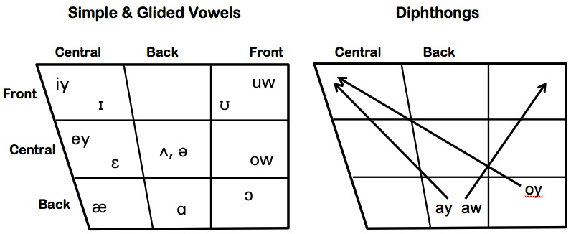
Vowels:
Tongue position
Lip rounding
Tense vs. lax
Simple vowels, glided vowels, and diphthongs

Slide 18
The musical aspects of pronunciation
  Syllables and word stress
  Rhythm
  Thought groups and pauses
  Prominence/sentence stress/focus
  Connected speech and linking
  Intonation

Slide 19


Syllables and word stress

Slide 20
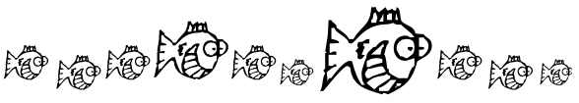
Rhythm

Slide 21

Thought groups, pauses, and prominence
When you’re at the beach/
you should wear sunscreen.

Slide 22
Intonation
When you’re at the beach/
you should wear sunscreen.

Slide 23
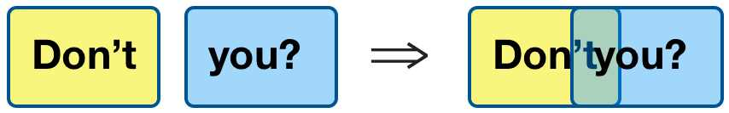
Connected speech and linking
/ʧ/

Slide 24
How can we teach pronunciation effectively?
Do more than simply teach rules and use mechanical drills.
Teach and practice both individual sounds and the musical aspects of pronunciation.
Use a variety of techniques and activities.

Slide 25
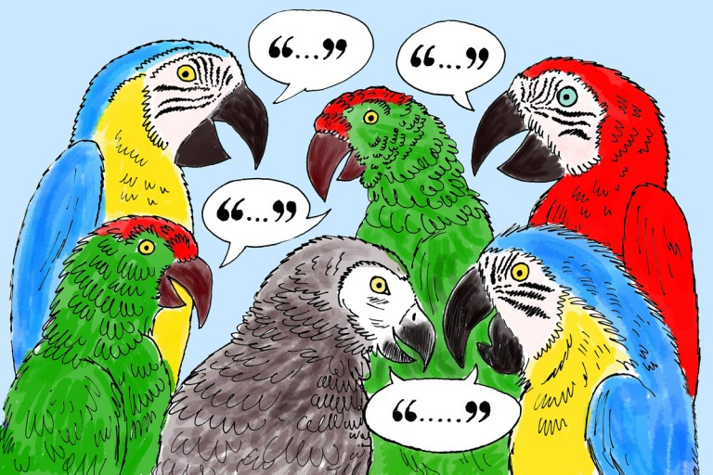
“Repeat after me” is useful, but it’s not enough for successful pronunciation teaching.
Use sight, movement, and meaningful activities.

Slide 26


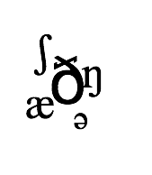

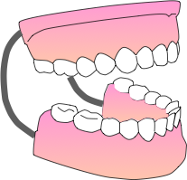

Sight

Slide 27
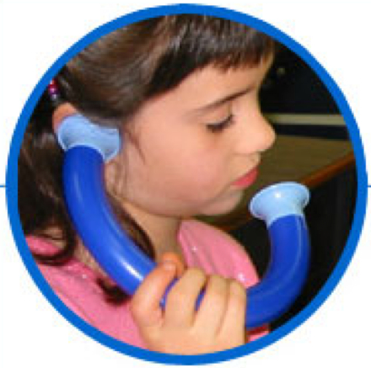
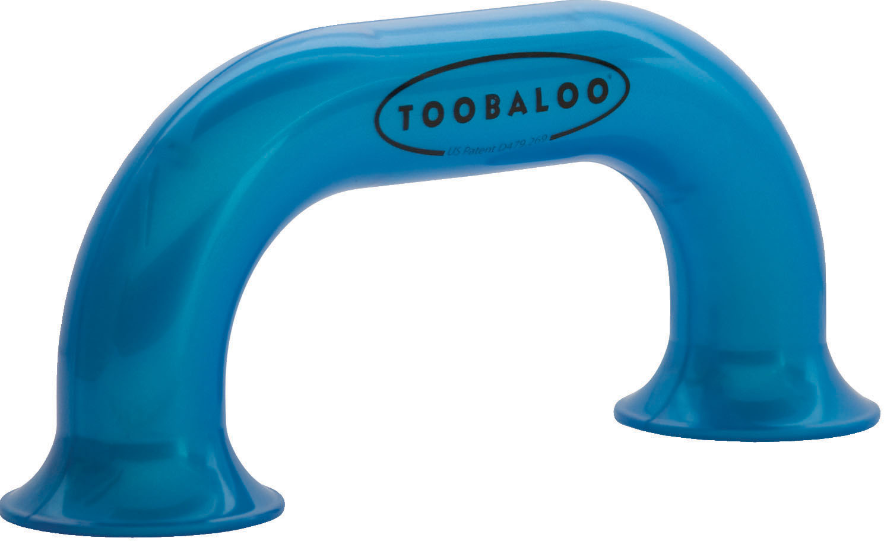
Sound: Listening Tubes
Students can hear their own voices more clearly while background noise is lessened.

Slide 28
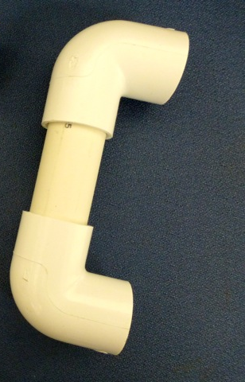
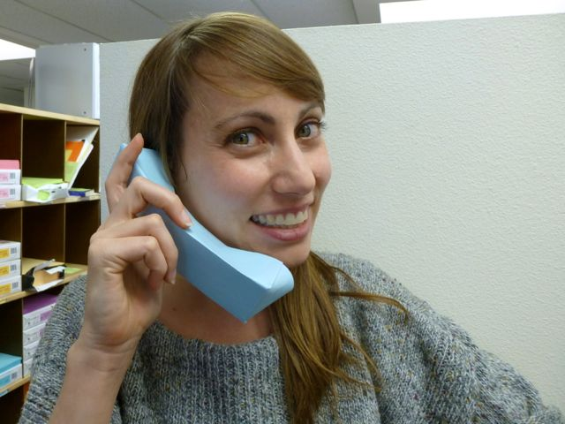
Sound: Listening Tubes
You can make your own from PVC pipe or heavy paper.

Slide 29




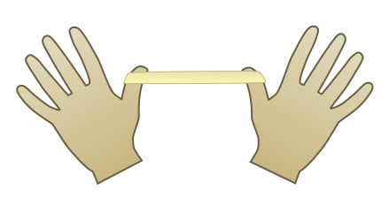
Movement: Practicing word stress
Try: classroom information volunteer

Slide 30

Movement: Thought groups & pauses
Try: You can lead a horse to water, but you can’t make him drink.

Slide 31


Movement: Connected speech
Try: Why can’t you run nine miles?

Slide 32
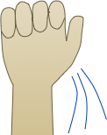
Movement: Prominence/sentence focus
Try: Grammar isn’t boring; it’s exciting.

Slide 33

Movement: Intonation
Try: Is today Friday? Yes, it is.

Slide 34
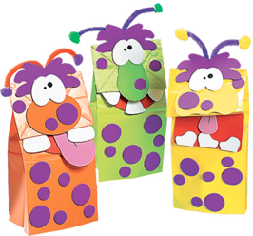

Drama Techniques
Plays, skits, role plays, puppets
Many students feel more comfortable trying out new sounds or intonation patterns when they’re pretending to be someone else.

Slide 35
Pronunciation practice activities:
A simple information gap

Slide 38
Meaningful
activities:
A family tree with /r/ & /l/
How could you practice with it?

Slide 39
Meaningful
activities:
A menu with
/f/, /v/, /p/, &
/b/ words
How could you practice with it?

Slide 40
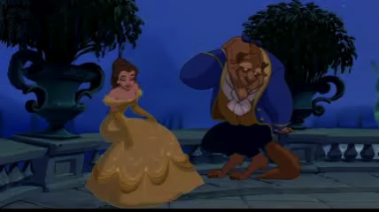
Students watch a video clip, then practice the dialog, trying to sound exactly like the characters.
Shadowing and Mirroring
Beast: Belle, / are you / happy here with me?
Belle: Yes.
Beast: What is it?
Belle: If only I could see my father again,/ just for a moment. // I miss him so much!

Slide 41
Use your imagination to find new ways to teach pronunciation communicatively and effectively.
For more ideas on teaching pronunciation:
http://teachingpronunciation.weebly.com

Slide 42
Use sight: “Sammy diagrams”

Slide 43
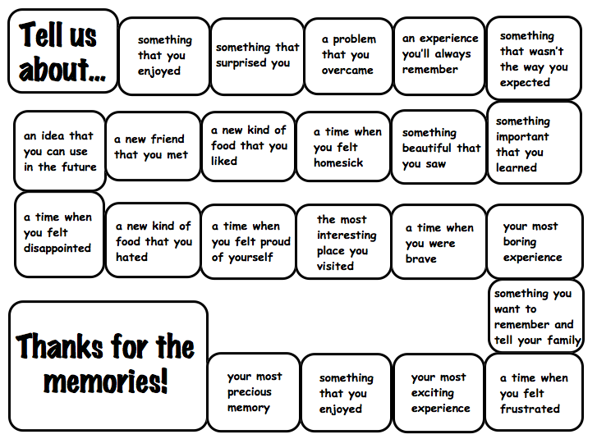

Try using games that get students to speak freely.
(“Lace” them with sounds you want to practice.”)
Pronunciation games for fluency

