Slide 1

Let’s Talk:
Communicative Activities
for Teaching Pronunciation
Marla Yoshida
University of California, Irvine
Division of Continuing Education
yoshidam@uci.edu

Slide 2
Why do we need communicative practice?
Students can say a sound successfully in isolation, but when they need to use it in speaking, it doesn’t come out smoothly.
That’s why we need communicative practice too—to build fluency as well as accuracy.
Speaking practice can also be pronunciation practice!

Slide 3
Communicative practice with sounds
Guided practice: A bridge to communication

Slide 4
Communicative practice with sounds

Slide 5
Family Tree
How could you use this for communicative pronunciation practice?

Slide 6
Communicative practice with suprasegmentals
Shadowing
Watch a short video clip repeatedly, trying to imitate the sounds, stress, pauses, and intonation exactly.
In groups, students create and perform their own role play as a variation or continuation of the video clip.

Slide 7
Communicative practice with suprasegmentals
Drama and role play
After practicing the intonation of questions and answers, requests, or other forms, have students role play a situation that requires the use of those forms.

Slide 8
Creative projects for pronunciation practice
Suit the content to students’ interests—anything from fairy tales to business presentations.
Students create videos related to their interests and needs. Cell phones make great cameras.

Slide 9
Creative projects for pronunciation practice
Websites and apps let learners make creative projects:
  Narrated PowerPoint or Keynote slideshows
  Adobe Spark: https://spark.adobe.com/ or on the Apple App Store
  Puppet Pals. Apple App Store.
  Voki: http://www.voki.com/
  Fotobabble: http://www.fotobabble.com or from the Apple App Store

Slide 10

Narrated PowerPoint or Keynote slideshow

Slide 11

Adobe Spark https://spark.adobe.com

Slide 12

Puppet Pals (Apple App Store)

Slide 13
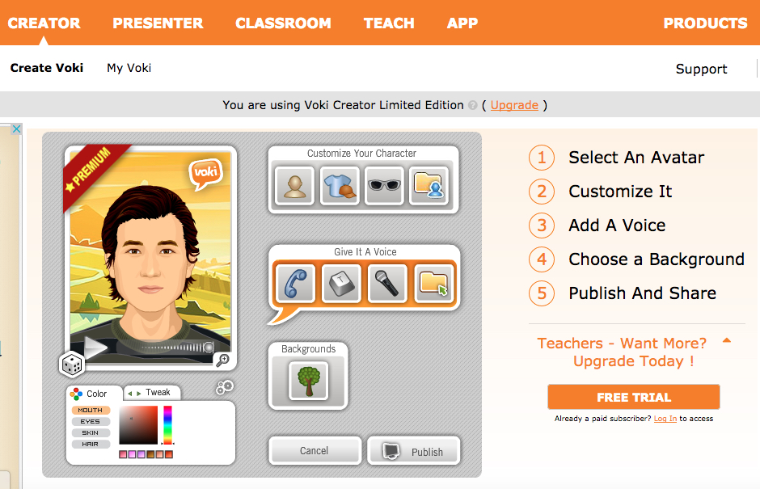
Voki http://www.voki.com

Slide 14

Voki http://www.voki.com

Slide 15
Pronunciation journals
Keep a record of words, sounds, or sentences that are hard to say.
Make the “problem words” the focus of communicative activities: Student-written stories, dialogues, or role plays.
Keeping a journal helps students recognize the connection of the classroom to their daily lives and increases motivation.

Slide 16
Pronunciation journals

Slide 17
Communicative practice
Communicative pronunciation practice helps students build confidence for real-life use of English!

Slide 18
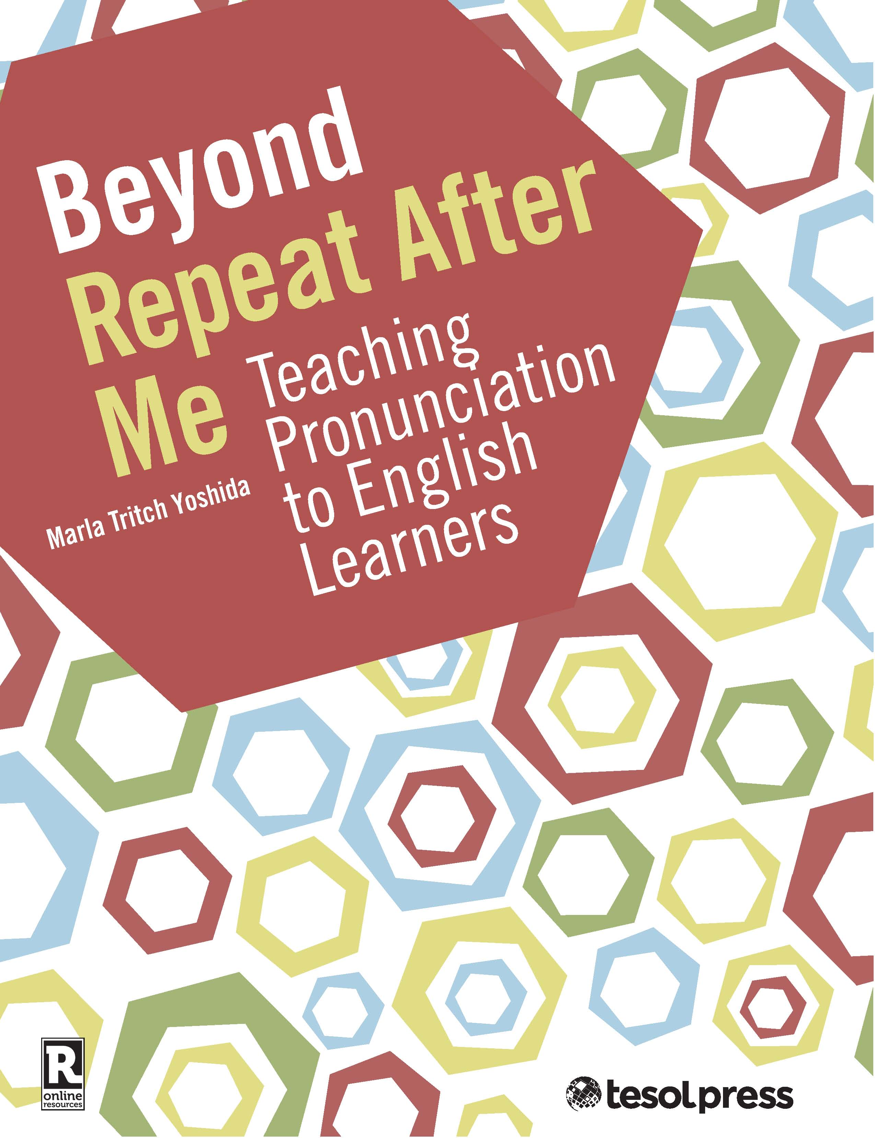
Contact Information
Marla Yoshida
yoshidam@uci.edu
Available from TESOL Press:
Beyond Repeat After Me: Teaching Pronunciation to English Learners

Slide 19
Questions?

